Slide 1
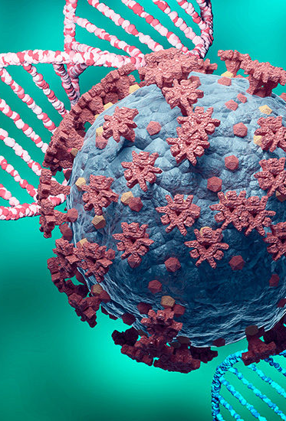
Genetic and inflammatory signatures associated with worse prognosis in hospitalized patients with severe SARS-CoV-2 infection and diabetes
Focus On Neanderthal Gene Expression

Slide 2
Related Studies
Tina Hesman Saey, The four Neanderthal genes that make COVID-19 worse
https://doi.org/10.1038/d43978-023-00032-9
Zeberg, H., Pääbo, S. The major genetic risk factor for severe COVID-19 is inherited from Neanderthals. Nature 587, 610–612 (2020). https://doi.org/10.1038/s41586-020

Slide 3
Introduction
Names
RPTN | Repetin: helps protect skin cells, and since the Neanderthals were missing this protein, they were better adapted to the cold, but less so to disease.
SPAG17 | Sperm associated antigen 17
CAN15 | Calpain 15
TTF1 | Transcription termination factor, RNA polymerase I
PCD16 | Protocadherin beta-16

Slide 4
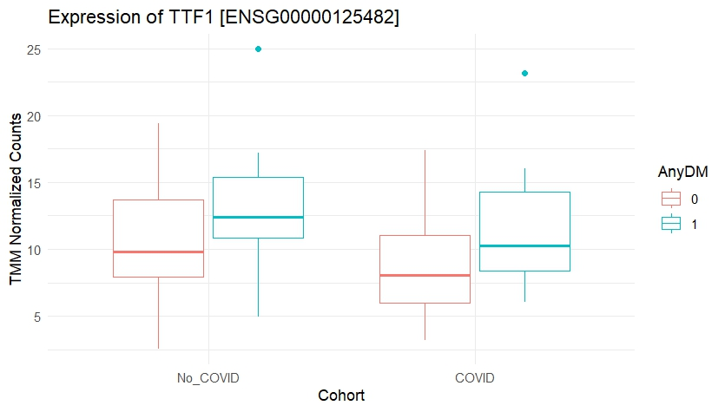
Analysis
data: ENSG00000125482 by AnyDM
t = -3.2043, df = 51.218, p-value = 0.002331
95% CI: [-5.035 -1.16]
data: ENSG00000125482 by Cohort
t = 2.1008, df = 37.842, p-value = 0.04238
95% CI: [0.083 4.49 ]

Slide 5
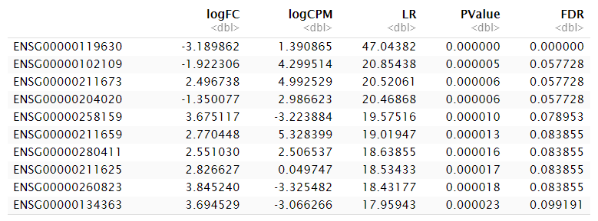
TMM Normalization

Slide 6
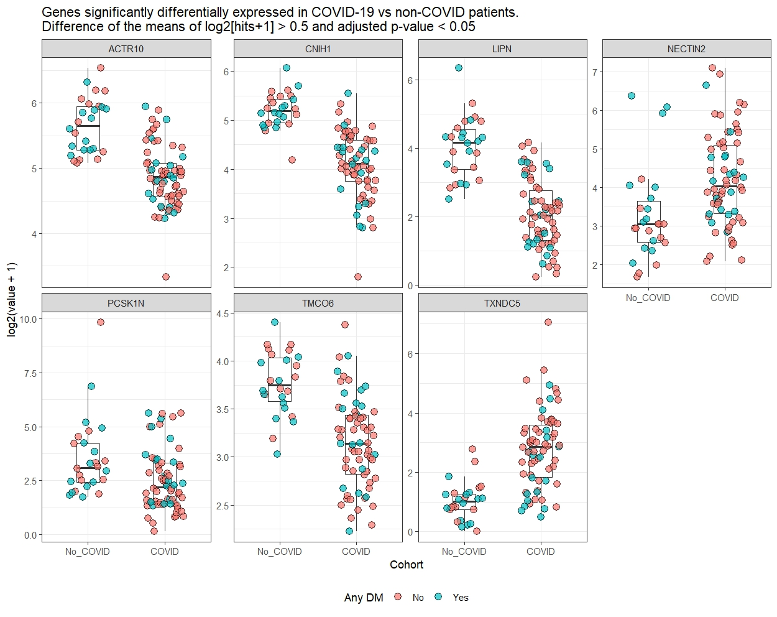

Slide 7
